Slide 1
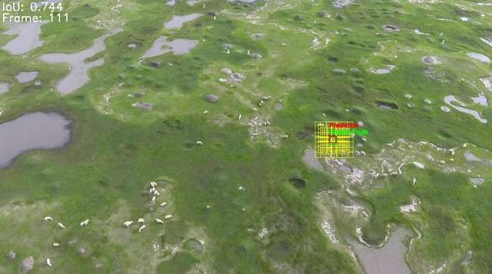
Object Tracking : Techniques and Implementation
Enhancing Accuracy in Dynamic Environments
Date : Thursday, 30th November 2024
Group : 7
Presented by : Ayush Saun (MT24024) , Gour Krishna Dey (MT24035), Karli Sahil (MT24133), Shristi Parajuli (MT24501) , Yash Choudhery (MT24147)
Guided by : dR. Vinayak abrol, Vishal kUMAR

Slide 2

Introduction
Overview of Object Tracking
Critical task in computer vision: used in surveillance, autonomous vehicles, video analysis.
Focus on Single Object Tracking (SOT).
Goal: Locate and follow a single object through video sequences, even under challenging conditions like occlusions and background clutter.
Key Challenges
Camera Motion Disturbances
Variations in Object Scale and Location
Lack of Robust Appearance Features
Temporal Inconsistency in Tracking
Predicting Object Trajectory Accurately

Slide 3
Method 1 - Camera Motion Compensation
Challenge : Camera motion causing tracking errors.
Solution : ORB-based keypoint detection and affine transformation estimation.
Stabilizes frames to focus on object, decoupling camera-induced disturbances.
Method 2 - Multiscale Search Windows
Challenge : Object size variations and rapid movement.
Solution : Dynamic, multiscale sliding window tracker.
Adjusts window size and position based on object’s last known location.
Ensures accurate tracking even with scale changes.

Slide 4
Method 3 - Enhanced Feature Extraction
Challenge : Appearance changes due to lighting, orientation, and occlusions.
Solution : Use of HOG, LBP, and SIFT-based keypoint matching.
Combines shape-based (HOG), texture-based (LBP), and scale-invariant (SIFT) features for robust appearance modeling.
Method 4 - Adaptive Template Update
Challenge : Temporal inconsistency due to gradual appearance changes.
Solution : Periodic adaptive template update with motion compensation.
Ensures reliable tracking by refreshing object appearance over time.
Method 5 - Hybrid Prediction Models
Challenge : Non-linear variations in object trajectory.
Solution : Position Prediction: Linear regression for (x, y) coordinates.
Size Prediction: Random forest regressor for bounding box dimensions.

Slide 5
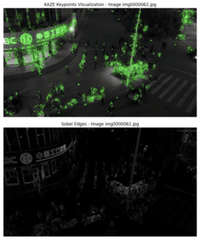
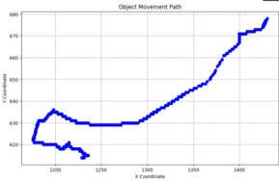
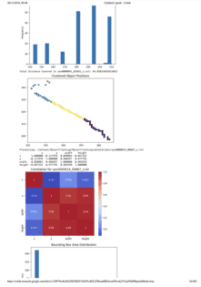
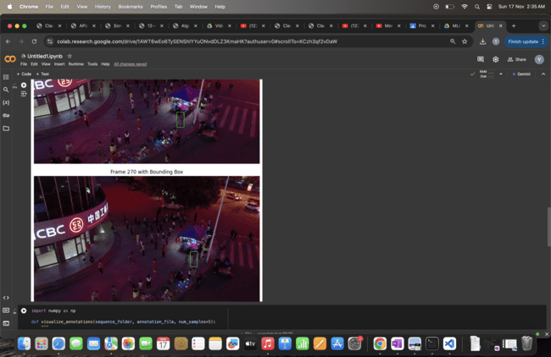
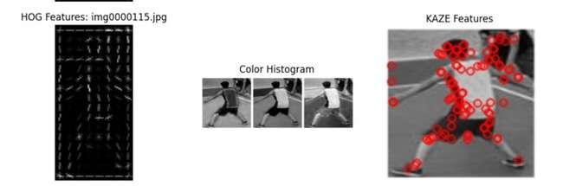
EDA

Slide 6
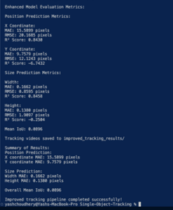
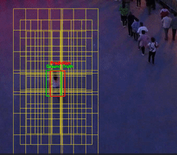
Visualizing Results
Tracking Visualization:
Predicted vs. ground truth bounding boxes.
Motion vectors indicating camera compensation.
Performance diagnostics via IoU scores.

Slide 7
Detailed Pipeline Overview
Stages of the Tracking Pipeline:
Initialization: Setup motion compensator, sliding window tracker, ML models.
Data Preprocessing: Camera motion alignment.
Feature Extraction: HOG, LBP, and SIFT features.
Model Training: Linear regression for position, random forest for size.
Testing and Inference: Predict position, size, refine with IoU.
Evaluation: Visualize tracking performance with metrics.

Slide 8
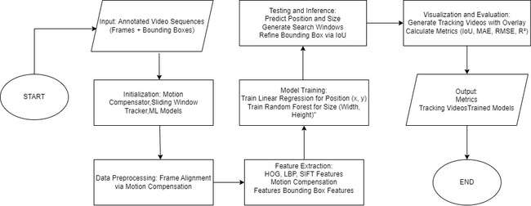
System Flowchart
Flowchart: Display the step-by-step process of the object tracking pipeline.
Input → Initialization → Data Preprocessing → Feature Extraction → Model Training → Testing → Visualization → Output

Slide 9
Conclusion
Key Achievements:
Combines motion compensation, multiscale tracking, feature enhancement, and machine learning.
High precision and robustness, even in dynamic and challenging environments.
Suitable for applications in surveillance, autonomous systems, and video analytics.
Future Work: Extending to multi-object tracking, incorporating deep learning for enhanced feature learning.
Citations:
Discusses relevant research papers on motion compensation, multiscale object tracking, and feature extraction for tracking.
Includes citations on machine learning in tracking, evaluation metrics, and hybrid frameworks.

